Slide 1
Cybersecurity for Future Presidents 2016
Lecture 1:
Where are we today?

Slide 2
Introductions
Who am I?
Who are you?
Why are we here?

Slide 3
Cybersecurity for Future Presidents
Carl E. Landwehr, Ph.D.
David Voorhees, Ph.D.
Aparna Das, Ph.D
What can we teach you now that will help you make the right decisions on cybersecurity matters in 20 years, when you have risen to a position of leadership in government or industry?
Goal: At the end of the course, you should
Understand, and be able to explain and apply basic, general concepts of computing, communications, and cybersecurity
Understand and be able to explain relevant laws, policies, social concerns and market forces surrounding cybersecurity issues
Be able to apply your understanding to assess critically arguments put forth in favor of alternative policy positions
Caution: This is the beta version after last year’s alpha! Plans may change a little as the semester progresses.

Slide 4
Some recent cybersecurity-related events
Some 2015 – 2016 events
Power grid cyber attacks: Israel (this week) Ukraine (late Dec.)
U.S. Cyber Command announcing forthcoming cyberattack capabilities
US – EU negotiating over privacy issues after “safe harbor” revoked
NY, CA proposing laws to ban smartphones with unbreakable crypto
Chrysler recalls 1.4M vehicles following hacking demonstration
Attacks on healthcare record systems: Primera, Anthem, Carefirst Attacks on government record systems
OPM penetrations (attributed to China)
Attacks on banks ($45M stolen after extensive reconnaissance)
Ashley-Madison – personal distress, possible suicides
Ransomware – stealing the right amount, payments via bitcoin
Volkswagen “defeat device” software – malware vs. insider threat

Slide 5
It’s a big problem now, but what are the long-term issues?
Can we build systems that aren’t so vulnerable?
If so, how to incentivize this?
If not, how to protect ourselves?
What kind of privacy do we want?
How do we provide accountability in computing and communication systems?
How do we protect information in the long term (e.g. genetic information)?
What’s the proper role for digital currency?
How do we establish international norms for cyberwarfare?
How should we vote in a digital age?

Slide 6
Planned Debate Topics
1. Resolved: The U.S. government should mandate that storage technology providers include a mechanism by which protected data can be obtained under lawful court order.
2. Resolved: The US should adopt the E.U. “right to be forgotten” online.
3. Resolved: The U.S. Election Assistance Commission should promote internet voting for public elections on a model similar to Estonia.
4. Resolved: Commercially stored genomic data requires no further government regulatory controls.
5. Resolved: The U.S. Treasury Department should treat bitcoin as currency rather than as property.

Slide 7
The Lecture on One Slide: Where are we today in cybersecurity?
What do we mean by “cybersecurity” ?
Key concepts that will recur
2. Recent occurrences in cyberspace
3. What does the U.S. President control?

Slide 8
Cybersecurity: security in cyberspace
Security
Originally (OED) freedom from anxiety or care (se + cura)
More recently (2011), OED added a definition:
Freedom from danger or threat: with reference to encryption, or telecommunications or computer systems: the state of being protected from unauthorized access; freedom from the risk of being intercepted, decoded, tapped, etc.
Note especially “threat” – security has to do not only with accidental, but also malicious acts
Cyber: Cybernetics: coined by Norbert Wiener, 1947
from Greek κυβερνήτης “steersman” or “governor”,
context of feedback control, automated steering (ships, guns)
Cyberspace What is cyberspace?
origins in sci fi of the early 1980s: Vernor Vinge True Names; William Gibson, Burning Chrome, Neuromancer
Cybersecurity: security in cyberspace

Slide 9
Privacy and Surveillance
Definitions of privacy
Privacy as Confidentiality: Dan Geer – “ability to lie about yourself”
Privacy as Contextual Integrity -- Helen Nissenbaum
Privacy as Practice (socio-technical) -- Seda Gursa
Surveillance and society
Visual surveillance:
Jeremy Bentham’s panopticon
See Illinois Stateville penitentiary, eg
Pervasive CCTV / webcams: David Brin’s Transparent Society, 1998; “Sousveillance” (from underneath)
Surveillance in cyberspace
Commercial: cookies, cameras, etc.
Governmental: CALEA, backdoors, etc. Warranted, unwarranted

Slide 10
Accountability and Anonymity
Accountability:
Ability to be called to account, take responsibility
Butler Lampson’s definition re spam
Forensics as a form of accountability
Anonymity
Ability not to be identified with some action
Pseudonymity (Federalist papers, e.g.)
Participation in experimental trials
Re-identification

Slide 11
Discussion
Are accountability and anonymity antithetical? Can we have both?
What about security and privacy? Can we have one without the other?

Slide 12
Cybersecurity and Economics
Information asymmetry and the market for lemons
Akerloff
Consumer can’t distinguish good car (secure system) from lemon (insecure system) and so market fails to reward producer of good car (secure system) and they disappear from market
Public goods: is cybersecurity a public good?
Schneider and Mulligan
Network security: non-rivalrous and non-excludable
Liability and insurance

Slide 13
Cybersecurity and Human Behavior
Central role of people in cybersecurity
(Pogo: “We have met the enemy, and he is us!”)
As consumers: What do we buy? How do we decide?
As individual users
As system administrators
As technology designers and developers
As hackers
As trolls

Slide 14
U.S. Government
Federal
Executive: President, Departments and Agencies
Legislative: Congress
Judicial: Supreme Court and District Courts
States
Governors, legislatures, courts
Local
Cities, towns, etc.

Slide 15
What does the President control? U.S. Government Departments with major Cybersecurity and Privacy concerns / responsibilities
Department of Defense: protecting, international surveillance, attacking; research (NSA, DIA, DARPA, … )
Department of Homeland Security: infrastructure protection
Department of Justice: prosecution of cyber-crime, anti-trust, FBI
Department of State: promulgating freedom of expression, authentication (passports)
Department of Treasury: protection of financial systems, national and international
Department of Commerce: international trade, standards (NIST)
Department of Health and Human Services: medical records (HIPAA), medical devices (FDA), medical research (NIH)
Department of Energy: nuclear weapons control, national labs (research)
Department of Transportation: aircraft and aviation system safety, drones (FAA); automotive safety (self driving cars?)
[there are 6 more departments – can you name them? – see below]
(USDA, ED, HUD, DOL, DOI, DVA)

Slide 16
What does the President control? Federal Agencies with Cybersecurity concerns/responsibilities
Intelligence agencies (CIA, NRO, NGIA,…)
Federal Trade Commission (privacy enforcement under fair business practices)
Federal Communications Commission (regulation of communication networks, “network neutrality” a current concern)
Securities and Exchange Commission (SEC) – securities trading
Federal Energy Regulatory Commission (FERC – power grid)
Nuclear Regulatory Commission (NRC) – reactor cyber security
National Science Foundation: research, education

Slide 17
Wrap up
It’s complicated!
But there are some underlying technical and policy issues that we can study and use to organize our understanding
What is a future President likely to face?
National security issues
Commerce and trade issues
Public health and welfare issues

Slide 18
Cybersecurity for Future Presidents: Flow – Planned 2016
Lecture 1: Course intro, Debate format, Where are we?
Debate #2: Right to be Forgotten
Debate 5: US Bitcoin transactiona are better for consumers than credit cards
Lecture 2: Data Representation
Mid-term
Lecture 9: Summation
Lecture 3: Cryptography technology and policy
Lecture 6:
Cybersecurity aspects of elections
Debate 3: EAC should encourage elections on Estonian model
Learning Objective #1 Technical Foundations
Debate #1: Law Enforcement Access to Encrypted Data
Lecture 7: Accountability and genomic data policy
Learning Objective #2 History / Policy Foundations
Lecture 4: Cybersecurity Foundations plus privacy policy
Debate 4: Commercial storage of genomic data need not be regulated
Lecture 5: How do Cyber Attacks Work?
Learning Objective #3
Critical Thinking
Lecture 8: Blockchains and digital currency, Treasury Policy
Spring Break!

Slide 19
Requirements and Policies*
Weekly homeworks
Assigned Wednesday, lab sessions on Friday, due Tuesday (unless otherwise specified). Some of the homeworks will involve writing, some technical.
Tests: Midterm (Friday, March 18 – following spring break) and Final (May 12)
Debates: There will be 5 debates on topics that relate cybersecurity technology and public policy. Each student will argue in one debate and be a questioner in all the others. These will be spaced throughout the term.
Grades based on: Homeworks and debates 40%, Midterm 30%, Final 30%.
Classroom policy: no laptops / tablets / phones please. Too distracting!
Collaboration policy: Working together to thoroughly understand the material is encouraged, but once you have things figured out, you must part company and compose your written answers independently. That helps you to be sure that you understand the material, and it obviates questions of whether the collaboration was too close.
Meet the professor: My office hours: Noon – 3pm Wednesday. Each student please sign up for one 15 minute slot so I can understand your interests and you can meet me.
*Please see Canvas pages for details. The Canvas pages are the authority.

Slide 20
Textbook and supplement
The text:
Brian Kernighan, D is for Digital, 2011
Readable, broad introduction to computing – hardware, software, communications, algorithms – for a general audience
We will skip around a bit in it, but I recommend reading all of it
First assignment: READ all of Chapter 2 for next week. Bring questions!
Supplement:
Ross Anderson, Security Engineering, 2nd Ed., 2008
available free online in chapters:
http://www.cl.cam.ac.uk/~rja14/book.html
Good depth on a wide range of topics. Use it if you are confused and want an alternative description of a topic

Slide 21
Ethics
We may talk about vulnerabilities in systems and attacks on systems
I want you to understand how the attacks work, because without it your ability to make good decisions will be limited
But be aware that actually attacking systems is in general both unethical and illegal!
People doing responsible research into vulnerability-finding need to behave ethically and responsibly
There are extensive discussions about what exactly this means in practice, but in general
If you find a vulnerability, first notify the person/organization who is in a position to fix it
Only after the fix has been distributed and installed is it appropriate to make public statements about it

Slide 22
Why Have Debates?
Help you learn to think critically about topics relating to both cybersecurity and public policy
Help you learn to express an oral argument
Expose different viewpoints on issues of current interest
Motivate the technical parts of the course
Prior to each debate, lectures and readings will cover material relevant to both technology and policy for that debate

Slide 23
Debate Procedures – In advance
Two 3-person teams, one to speak in favor of the resolution (PRO), one against (CON). Toss of coin to see which side goes first.
In advance, each side prepares a position paper (one paper per team), 2500 words (about 5 pages), with references, presenting the team’s position.
One student (or more!) from each side visits me for 15 minutes to discuss the team’s plan
Non-debaters review provided materials and draft one question for each side (this is the homework for debate weeks)

Slide 24
Debate Procedures – Day of the Debate
On the day of the debate (note: PRO and CON order may be interchanged based on coin toss)
<initial vote>
PRO presents opening statement (5 min.)
CON presents opening statement (5 min.)
<brief pause for preparation> (3 min.)
PRO presents rebuttal (5 min.)
CON present rebuttal (5 min.)
<brief pause> (3 min.)
PRO presents closing statement (5 min.)
CON presents closing statement (5 min.)
Questions are posed to each side by moderator and/or professors (10 min.)
<final vote>

Slide 25
Backup slides and callouts

Slide 26
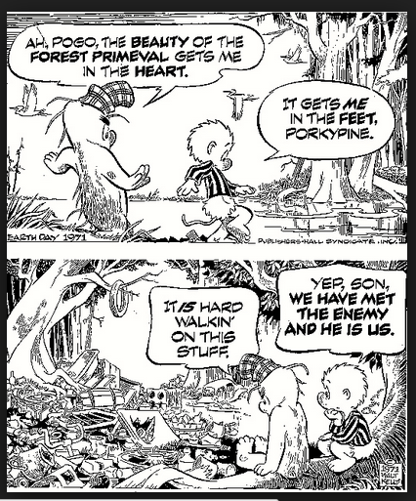
Pogo
by
Walt
Kelly
<back>

Slide 27
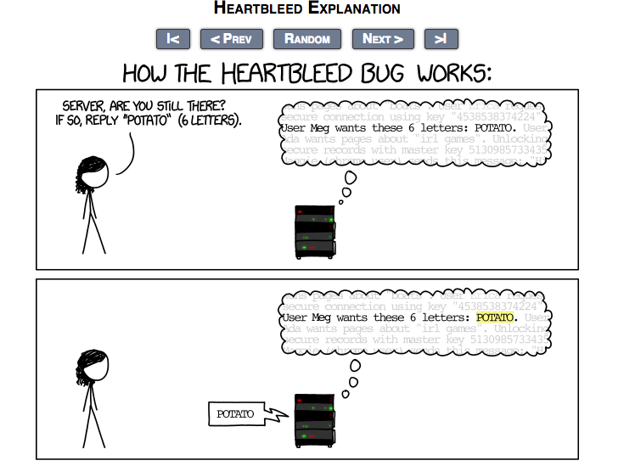
From XKCD cartoons: http://www.xkcd.com/1354/

Slide 28
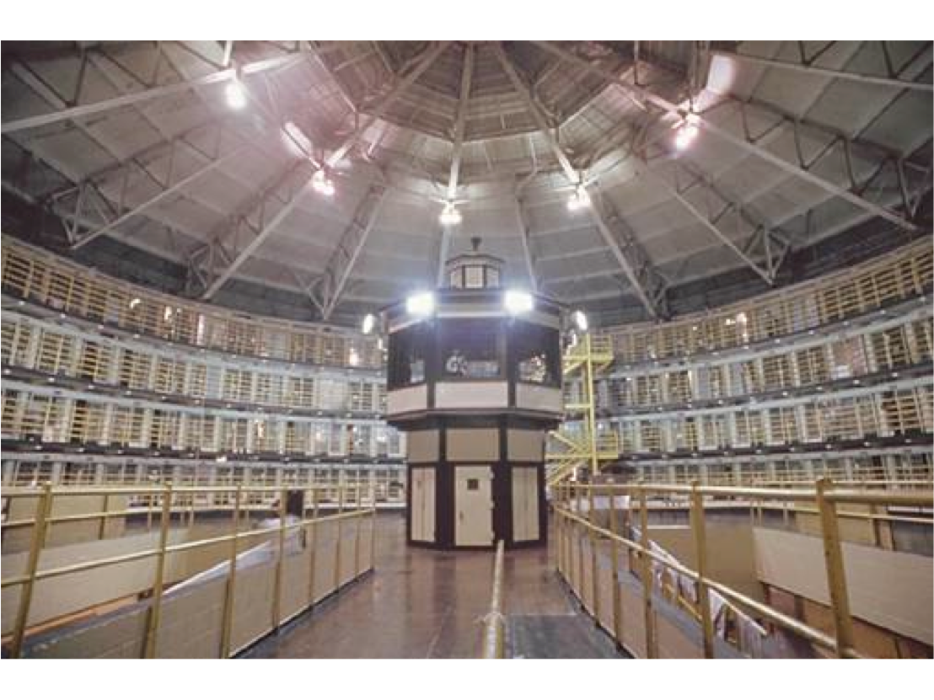
Panopticon – Stateville penitentiary, Illinois

Slide 29
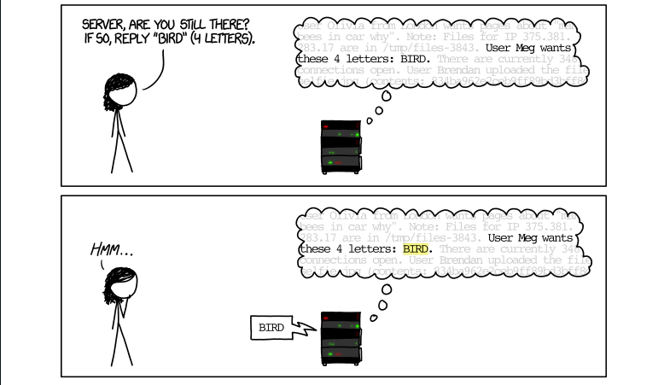
From XKCD cartoons: http://www.xkcd.com/1354/

Slide 30
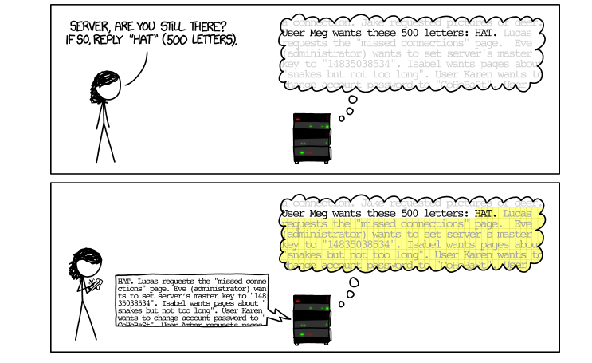
<Back>
From XKCD cartoons: http://www.xkcd.com/1354/

Slide 31
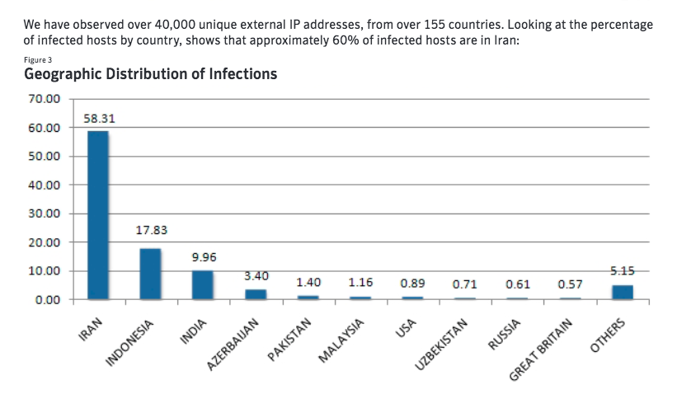
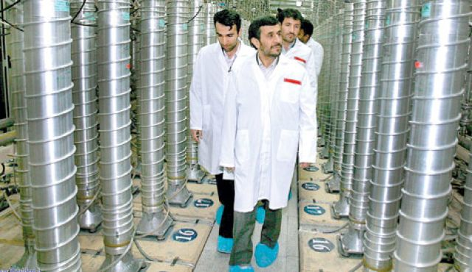
From Symantec’s report on Stuxnet: global infection rates
<back>

Slide 32
Some Current U.S. Federal Laws and Regulations relating to Cybersecurity, including Privacy
Wiretapping / surveillance:
Domestic telephone calls: In general, federal wiretaps are permitted only if a warrant has been issued (this requires a judge to approve a detailed request) [ref: episodes of “The Wire” ]
Domestic e-mail: Stored Communications Act (SCA)
Foreign / national security surveillance: Foreign Intelligence Surveillance (FISA) act, PATRIOT Act
Healthcare information: HIPAA (Health Insurance Portability and Accountability Act) 1996
Financial records and information:
GLB: Graham-Leach-Bliley 1999 – requires written security plan to protect client nonpublic data
SOX: Sarbanes-Oxley Act 2002 – accountability for internal controls on financial reporting, fraud prevention/detection

Slide 33
Security Breach notification laws in the U.S.
California passed a laws requiring notification of breaches of unencrypted personal data in 2002
As of 2014, 47 states in the U.S. have passed laws requiring private or government entities to notify individuals of security breaches of information involving personally identifiable information (“PII”)
Verizon now publishes and annual “Data Breach Report” summarizing results of the past year
U.S. Congress has had several bills introduced to establish a national standard for breach notification, but none have passed

Slide 34
Additional Breach Examples
Retail: Home Depot breach
POS malware installed mainly on self-checkout lanes in 1,700+ stores; 56,000,000 credit cards collected over period 4/14 – 9’14
How: “BlackPOS” malware variant, according to KrebsOnSecurity
Reported 9/2/14++
Estonia (2007): large scale denial of service attacks cripple national economy for several days following removal of Soviet era statue from prominent public location. Russian government/”citizen hackers” strongly suspected, not proven
“Aurora” attacks on Google and 20 other companies (2009-2010): “zero-day” vulnerabilities in Internet Explorer and other means used to compromise systems; backdoors installed to communicate with remote servers and exfiltrate intellectual property (e.g. programs). Chinese involvement strongly argued.
Saudi-Aramco cyber attack (Aug. 2012): “Shamoon” virus damages thousands of computers at government oil company; large scale hardware replacements required. Hacker group claims credit; Iranian participation strongly suspected.

Slide 35
Additional security infrastructure breach examples
Shellshock (2014): widely used open source software turned out to have an exploitable flaw; servers might execute bogus privileged commands. Had been in place for many years. Highlights latent vulnerabilities in open source software.
RSA breach (2011): attack on major supplier of certificates and tokens compromised security infrastructure. Highlights effectiveness of “spear-phishing” in conjunction with latent vulnerabilities in software, even in sophisticated security firms.
Diginotar: Dutch certificate issuing company suffers security breach and is discovered to have issued fraudulent certificates facilitating man-in-the-middle attacks. Highlights vulnerabilities of certificate-issuing infrastructure

Slide 36
Some Current U.S. Federal Laws and Regulations relating to Cybersecurity, including Privacy (1 of 3)
Wiretapping / surveillance / law enforcement:
Title III of Ominibus Crime Control and Safe Streets Act of 1968. Federal wiretap law specifies basis for legal wiretaps.
Electronic Communications Privacy Act (ECPA) of 1986; intended to control wiretaps but now somewhat outdated
Incorporates/updates “Title III” of Ominibus Crime Control and Safe Streets Act of 1968.
Federal wiretap law specifies basis for legal wiretaps.
PATRIOT Act
FISA / FISA Amendments Act
Stored Communications Act
CALEA

Slide 37
Some Current U.S. Federal Laws and Regulations relating to Cybersecurity, including Privacy (2 of 3)
Healthcare information:
HIPAA (Health Insurance Portability and Accountability Act) 1996
Financial records and information:
GLB: Graham-Leach-Bliley 1999 – requires written security plan to protect client nonpublic data
SOX: Sarbanes-Oxley Act 2002 – accountability for internal controls on financial reporting, fraud prevention/detection

Slide 38
Some Current U.S. Federal Laws and Regulations relating to Cybersecurity, including Privacy (3 of 3)
Government systems
Privacy Act of 1974: focus on government databases, 6 “Code of Fair Information Practices” established; amended 1988.
FISMA: Homeland Security Act (includes Federal Information Security Management Act
Children:
COPPA: Child’s Online Privacy Protection Act 1998
Controls online collection of information from children < 13 years. Not really cybersecurity per se

Slide 39
Some recent happenings – II: Security Infrastructure
Heartbleed (2014):
widely used open source software for SSL
Had an exploitable flaw;
buffer overflow problem could allow sensitive data to be scavenged.
Had been in place for years.
Highlights latent vulnerabilities in open source software.
XKCD Heartbleed Explanation:
http://www.xkcd.com/1354/
Or see callouts
2015

Slide 40
Some recent happenings – III: Govt. / Military
Stuxnet (2010): “SCADA” system attack.
Targeted malware exploits several “zero-day” vulnerabilities
Causes physical damage to Iranian centrifuges on “air-gapped” network;
Widely seen as nation-state attack and attributed to US/Israel.
<geographic infection rates and photo>
2015

Slide 41
Other recent happenings
Sony breach
Snowden disclosures: discuss
Activities of “Anonymous” hackers
Ferment in Intellectual Property business models
2015

Slide 42
 | Lecture |  | Lab | HW
1 – Jan 27 |  | Intro / Where are we today? | Set up debate teams | Watch a debate
2 – Feb 3 |  | Data representation, analog and digital
3 – Feb 10 |  | Cryptography technology and policy
4 – Feb 17 | Debate 1 | The U.S. government should mandate that communications and storage technology incorporate mechanisms to ensure law enforcement access to information under lawful court order.
5 – Feb 24 |  | What is cybersecurity about? What is privacy about?
6 – Mar 2 |  | How do cyberattacks work?
Mar 9 |  | <no class> | Spring | Break
7 – Mar 16 | Debate 2 | Congress should adopt the EU’s “Right to be forgotten” online | MIDTERM
8 – Mar 23 |  | Cybersecurity aspects of elections |  | Easter
9 – Mar 30 | Debate 3 | U.S. Election Assistance Commission should promote Internet elections along Estonian model
10 – Apr 6 |  | How is accountability provided within a computer? + genomic data policy background
11 – Apr 13 | Debate 4 | Commercially stored genomic data needs no further regulation
12 – Apr 20 |  | Blockchains, digital currency, and Treasury policy
13 – Apr 27 | Debate 5 | U.S. Treasury should treat bitcoin as currency
14 – May 4 |  | Summation | FINAL

